Slide 1


Cricket PoseNet : AI Shot Recognition
A Deep Learning Approach with Fast API, ReactJS, and Tailwind CSS
Submitted by :
Submitted to :
Mohd Umair (22733)
Shri Kant (22755)
MCA Final Year
Prof. Aasha Singh
Prof. Kriti Chaurasia

Slide 2

Agenda
Introduction
Frontend Development
Fast API Integration
Backend Processing
Overview
Model Architecture
Model Performance Metrics
Demonstration
Conclusion: Project Impact & Future Work

Slide 3
Introduction
1
2
3
Project focuses on classifying cricket shots using image data and deep learning.
Frontend development utilizes React JS and Tailwind CSS to create user-friendly website for image input and result display.
Backend processes include image augmentation, keypoint extraction, data normalization, and training a pytorch model for shot classification.

Slide 4
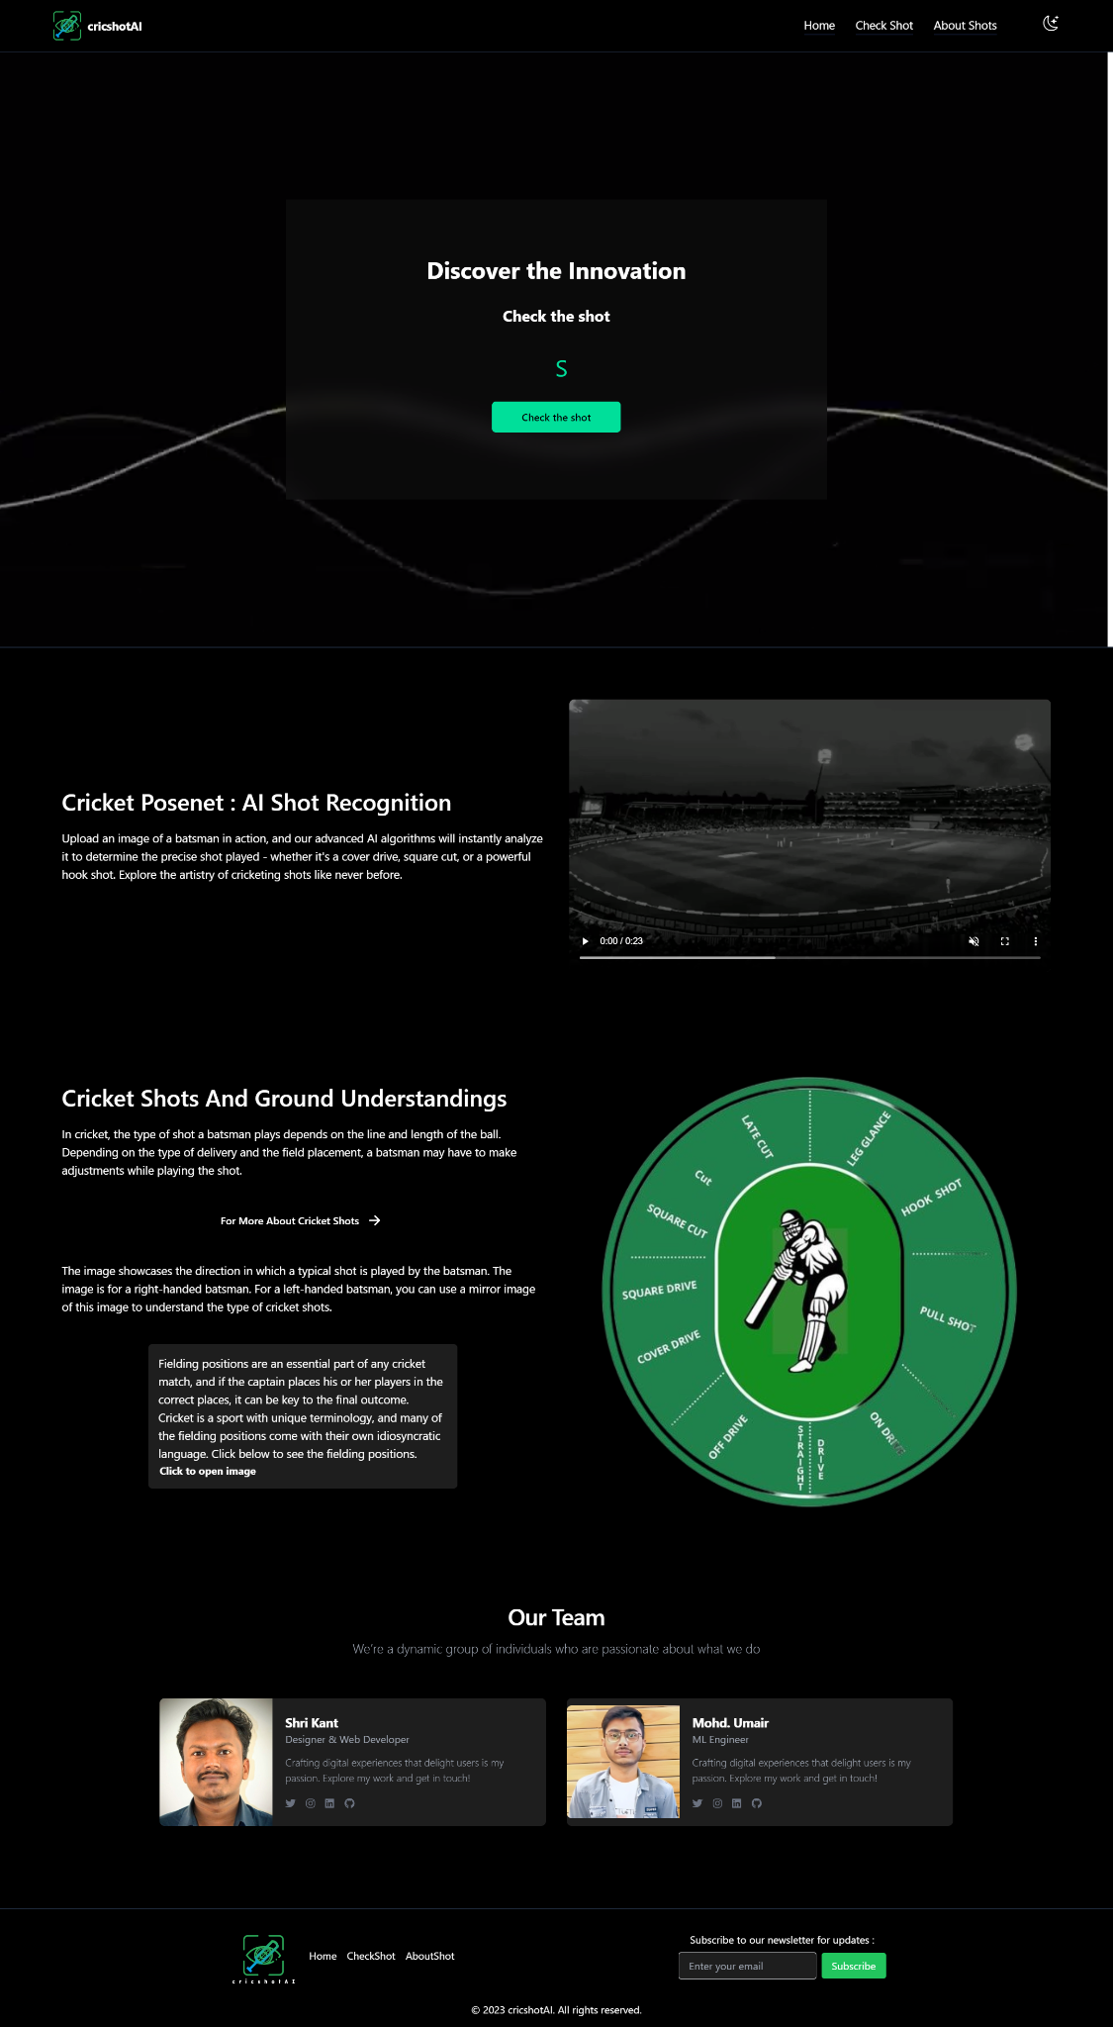
Frontend Development
Key Highlights
Utilized ReactJS for building a dynamic and interactive UI
Implemented Tailwind CSS for efficient styling and customization
Integrated the frontend to the FastAPI backend for seamless communication
Developed an image upload component
Displayed the predicted result

Slide 5

FastAPI Integration
High-performance, web framework for building APIs
Create the endpoint API that takes an image as input and returns the predicted result
Robust and efficient way to handle the communication between the frontend and the deep learning model.

Slide 6
Backend Processing
Use of FastAPI to create an efficient endpoint API for the model.
Utilization of Image Augmentation to enhance the training data for the model.
Key point extraction using Detectron2 for identifying important features in the images.

Slide 7
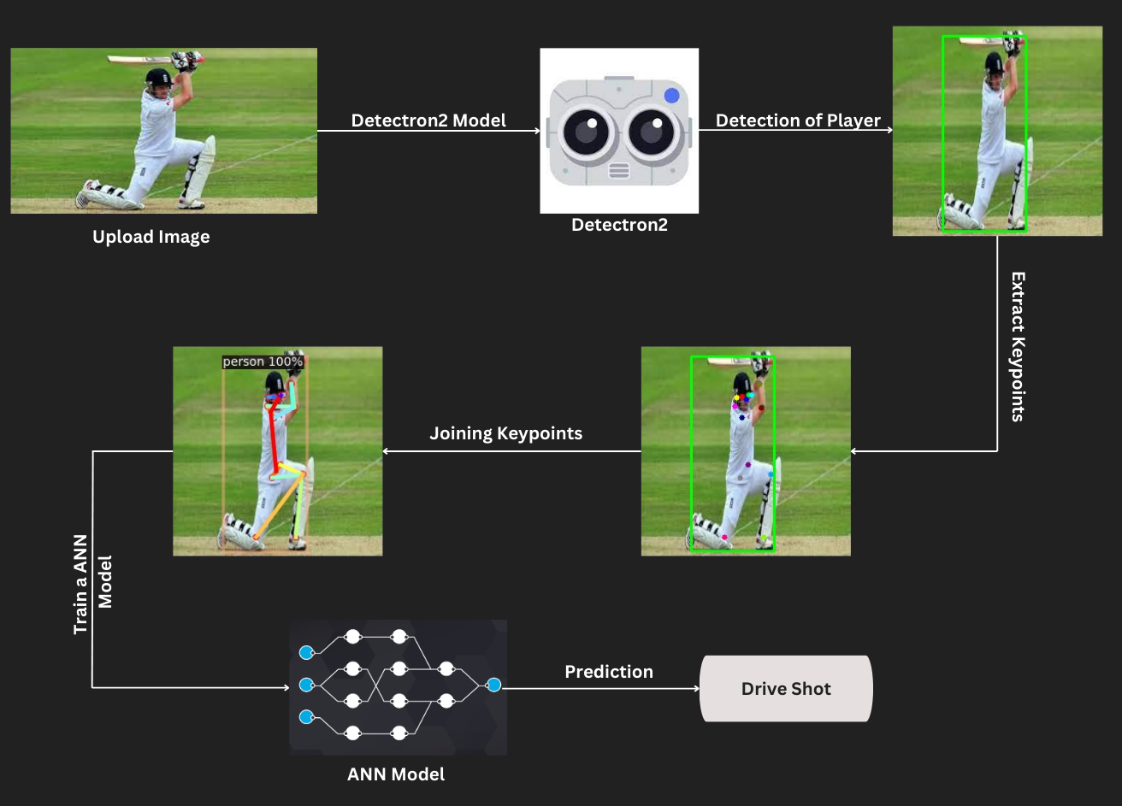
Overview

Slide 8
Model Architecture
The model is built using PyTorch and consists of an Artificial Neural Network (ANN) with multiple layers, capable of classifying cricket shots based on image inputs.
The model include various activation functions like Relu, LeakyRelu, Softmax, and the use of the Adam optimizer for efficient training.
The criterion for the model is the Cross Entropy Loss, a suitable choice for multi-class classification tasks, ensuring a penalization for the deviation of each prediction from the actual category.

Slide 9
Model Performance Metrics
90.25%
83.98%
0.88
Training Accuracy
Testing Accuracy
Precision

Slide 10
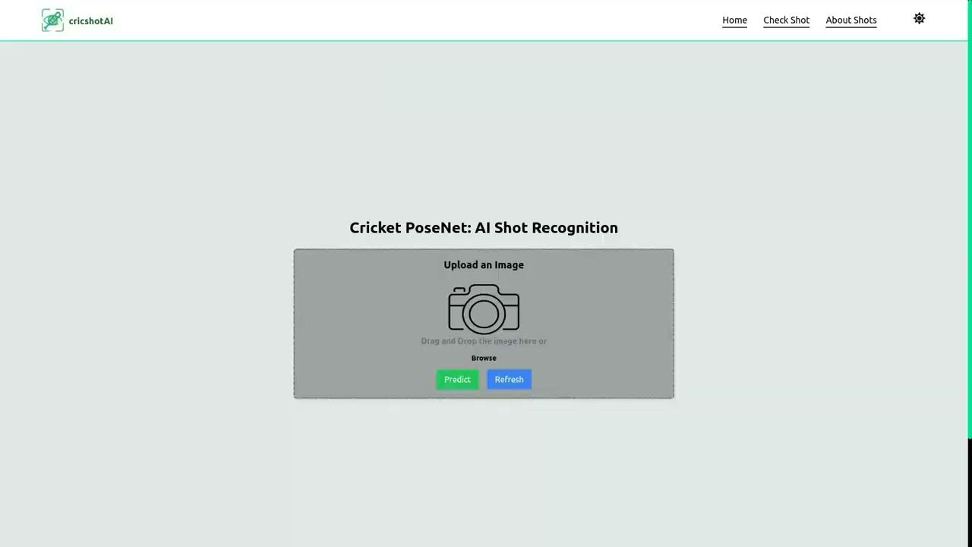
Demonstration

Slide 11
Conclusion: Project Impact & Future Work
Impact
The use of Detectron2 for keypoint extraction proves to be a valuable feature, contributing to the model's success.
Future Work
Expanding the dataset to include more diverse cricket shots, and integrating video classification and user feedback.
Challenges & Learnings
The project encountered challenges in data collection and performance optimization. However, these challenges provided valuable insights and learnings in the areas of data preprocessing, model tuning, and deployment.

Slide 12
Thank You!
We are grateful to our academic mentors for their guidance and support throughout this project.

